Slide 1
Year-End Exam Revision

Slide 2
Revision Topics
Multiplication
Division
Money
Time
Pictogram

Slide 3
Exams are drawing near. How do you feel?
Scared
Stressed
Excited
Worried
Tired

Slide 4
01
Multiplication

Slide 5
Which One Represents 4 x 5?
4 + 4 + 4
*****
*****
*****
*****
A B C

Slide 6
Next Question

Slide 7
Which One Represents 5 x 5?
***
***
***
***
5 + 5 +
5 + 5 +
5 + 5
A B C

Slide 8
Next Question

Slide 9
Which One Represents 7 x 3?
3 + 3 + 3 + 3 + 3 + 3 + 3
*******
*******
A B C

Slide 10
Next Question

Slide 11
02
Division

Slide 12
24 ÷ 2 =
2
2
4
2
4
4

Slide 13
Next Question

Slide 14
18 ÷ 3 =
3
1
8
1
8

Slide 15
Next Question

Slide 16
15 ÷ 5 =
5
1
5
1
5

Slide 17
Next Question

Slide 18
03
Money

Slide 19
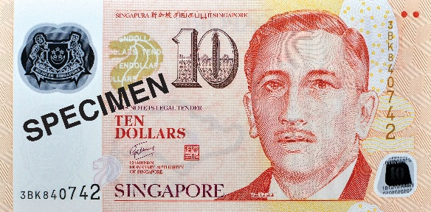
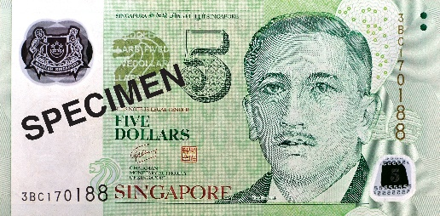
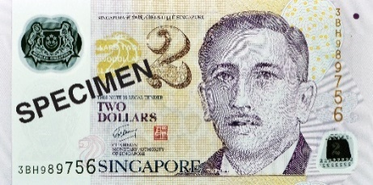
How much money is there?
$

Slide 20
Next Question

Slide 21
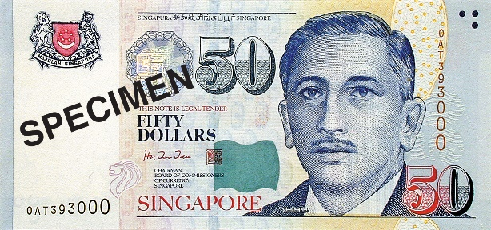
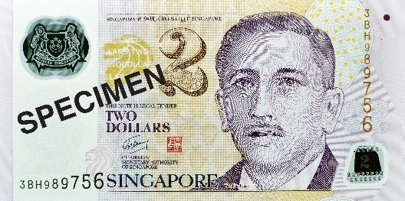
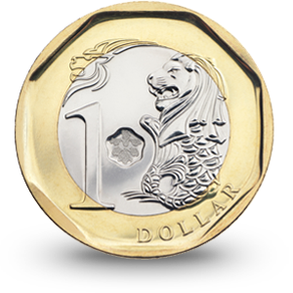
How much money is there?
How much money is there?
$

Slide 22
Next Question

Slide 23
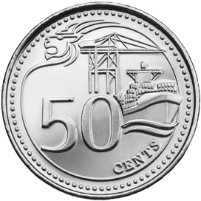
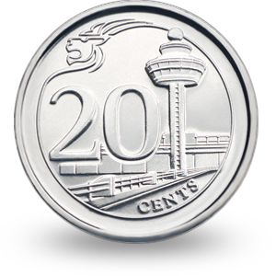
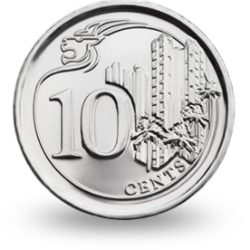
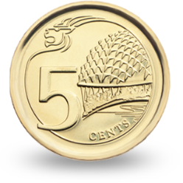
How much money is there?
How much money is there?
¢

Slide 24
Next Question

Slide 25
04
Time

Slide 26
Match to the correct clocks!
half past 3
half past 9
half past 1

Slide 27
Next Question

Slide 28
Match to the correct clocks!
10 o’clock
8 o’clock
12 o’clock

Slide 29
Next Question

Slide 30
05
Pictogram

Slide 31
This pictogram shows favourite fruits in
Primary 1 Columbus
Which is the most popular fruit?
Grapes
True or False?
Bananas
Grapes
Apples
Pears

Slide 32
Next Question

Slide 33
How many more children like black cars
than green cars?
How many more children like black cars than green cars?
7
True or False?
Red
Blue
Green
Black
White

Slide 34
Thank You

Slide 35
Whiteboard Background

Slide 36
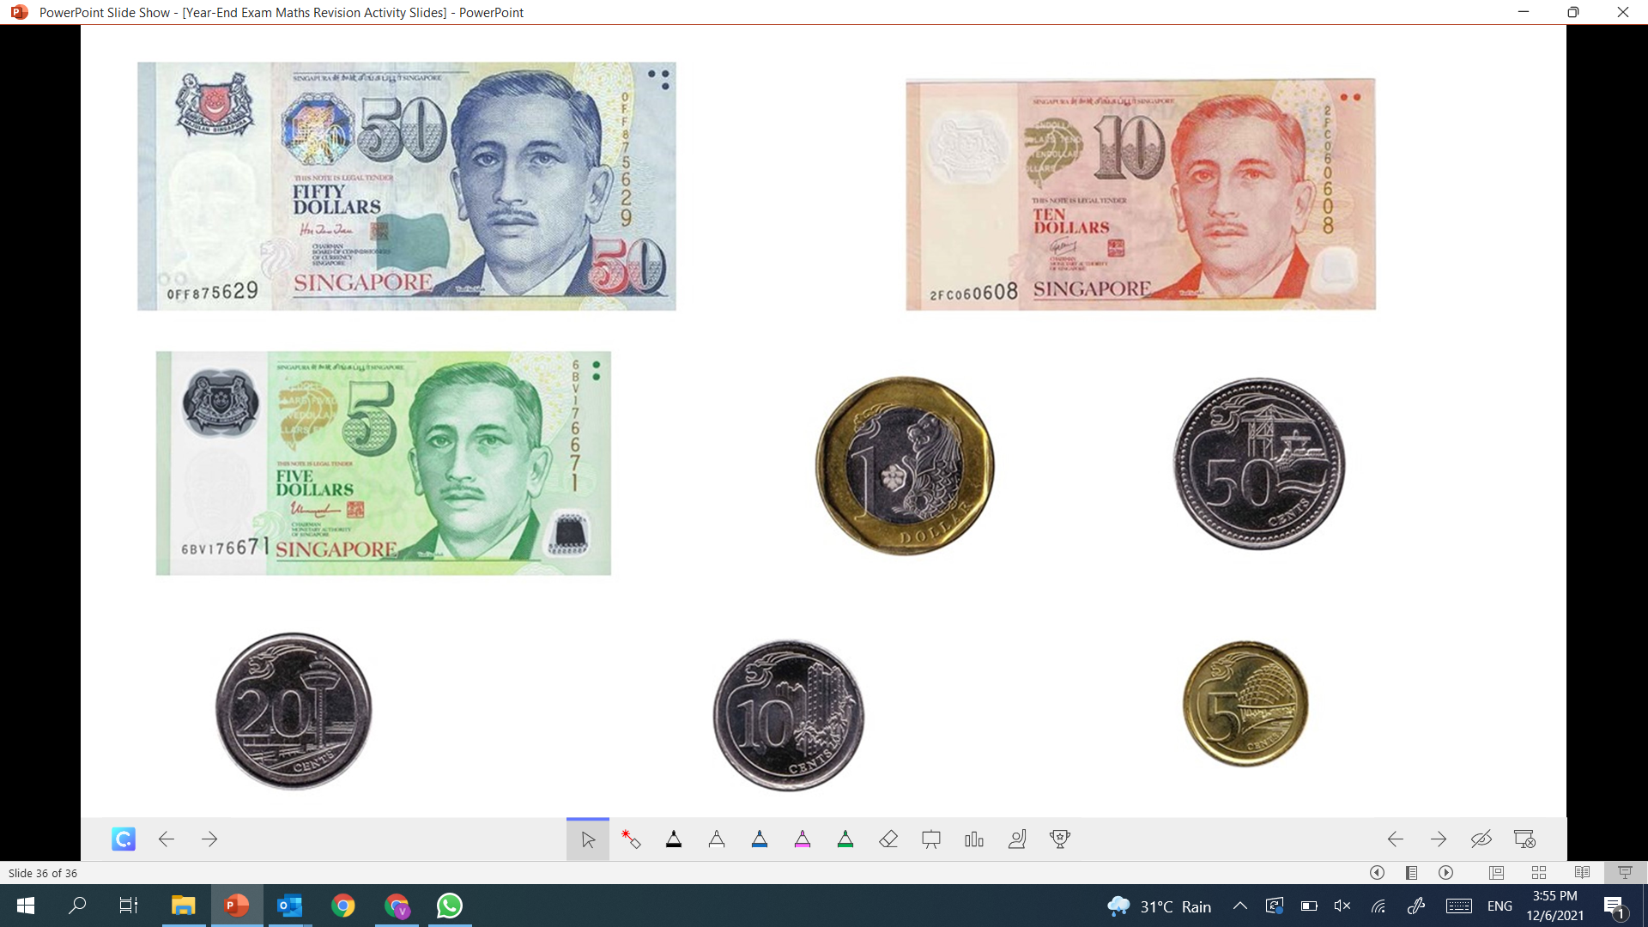
Notes:
You can save this slide as your whiteboard background. To find out how, watch this short tutorial https://www.youtube.com/watch?v=UEGooOPHgbM.

