Slide 1



Slide 2
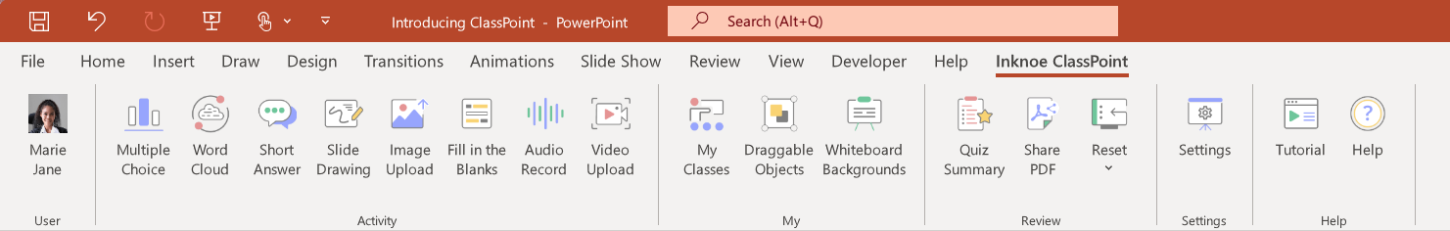

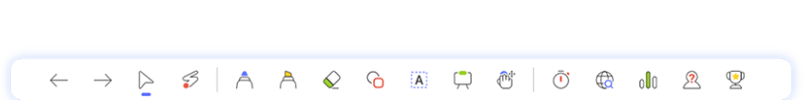
How to Use This Template:
Download ClassPoint to access the following features in PowerPoint.
Class List
Draggable Objects
Add wheel of fortune
options to Class List.
Reveal the letters on the
puzzle board using “Draggable Objects”.
Set up the puzzles.
Tabulate the scores each round under
the bottom of the puzzle board.
Timer
Name Picker
Spinning Wheel
Keep track of time
in the bonus round.
Spin the wheel using “Name Picker”.

Slide 3
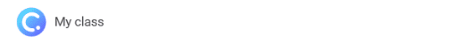
To gamify your Wheel of Fortune PowerPoint slides:
Once you have downloaded ClassPoint and signed in, go to Class List at your PPT ribbon.
(Important) If you have added a Class List for the Wheel of Fortune reward options to be spun using Name Picker, you will have to “Add New Class” for the contestant names.
Add the contestants’ names/teams’ names.
Start the game.
Award stars for each round by going to “My Classes” or “Name Picker” tab at the ClassPoint toolbar during slide show mode. (Remember to switch to the Class containing the right list (list containing Wheel of Fortune reward options or list containing contestants’ names) by clicking on the Class Code on the top right corner or “My Class” on the bottom left corner of the screen.
Access the leaderboard at the ClassPoint toolbar during slide show mode.
Leaderboard

Slide 4
Toss-up Round
Contestants buzz in/raised hand to solve a puzzle with missing letters.
The first who buzzed in/raised hand and solved the puzzle wins cash and
starts the next round.
Set the amount of cash/rewards for the contestant who wins this round.

Slide 5
Main Game/Round 2-3
Contestants take turn spinning the Wheel/Name Picker and call a consonant. After
calling a consonant, a contestant can buy vowels, attempt to solve the puzzle, or re-spin
until a miss, Bankrupt, or Lose a Turn.
If the wheel stops at:
  Cash Wedge and the participant guesses a correct consonant, the contestant wins
  the cash multiplies by the number of times the consonant appears in the puzzle.
  Prize Wedge and the contestant guesses a correct consonant, the contestant wins
  the wedge.
  Wild Card, the contestants retain their turn and add an additional consonant.
  Gift Tag, the contestants win $1,000 from a sponsor if they correctly guessed a
  consonant and subsequently solve the puzzle.
In Round 2/Mystery Round, if the wheel stops at Mystery Wedge and the contestant
guesses a correct consonant, the contestant has the choice to:
    Receive $1,000 for each letter in the puzzle or
    Chance of receiving $10,000 or a Bankrupt.

Slide 6
Main Game/Round 4/Speed-Up Round
Round 4 is also the final round in the main game where the host takes the final spin.
Whatever the wheel lands on is the cash value each correctly guessed consonant will be worth.
In the speed-up round, vowels are not worth anything.
Contestants take turns guessing consonants and can buzz in to solve the puzzle.
The first contestant to solve the puzzle wins the cash accumulated during the Speed-Up
Round.

Slide 7
Bonus Round
The contestant with the highest scores proceed to the bonus round.
The host reveals all the R, S, T, L, N and E in the puzzle.
The contestant selects additional letters from the puzzle.
The contestant is given 10 seconds to guess the puzzle.
If the contestant guesses the puzzle correctly within the 10 seconds, the contestant
wins additional bonus prize.

Slide 8
TOSS-UP
ROUND

Slide 9
Contestant
Puzzle board
Name
Drag me using ClassPoint’s
Draggable Objects to move in slide show mode.
M
A
Y
T
H
E
F
O
R
C
E
B
E
W
I
T
H
Y
O
U
Contestant 1
Contestant 2
Contestant 3
Totals
Totals
Totals

Slide 10
ROUND 2/
MYSTERY

Slide 11
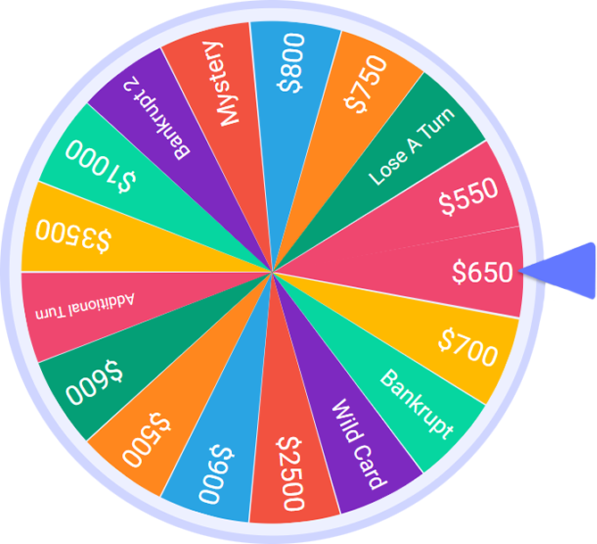
Spin the wheel
Follow the instruction and enter slide show mode to spin.
1st Contestant
(won toss-up round)
You landed on
Download ClassPoint for free.
Go to Inknoe ClassPoint in your PowerPoint ribbon
and click on “Class List”.
Upload this CSV file with a list of Wheel of Fortune
options to the “Class List”.
4. Enter slideshow mode and click on “Name Picker” at
the ClassPoint toolbar at the bottom of your screen.
Spin the wheel and record where the wheel stops
on this PowerPoint slide.

Slide 12
Spin the wheel
Follow the instruction and enter slide show mode to spin.
2nd Contestant
You landed on
Download ClassPoint for free.
Go to Inknoe ClassPoint in your PowerPoint ribbon
and click on “Class List”.
Upload this CSV file with a list of Wheel of Fortune
options to the “Class List”.
4. Enter slideshow mode and click on “Name Picker” at
the ClassPoint toolbar at the bottom of your screen.
Spin the wheel and record where the wheel stops
on this PowerPoint slide.

Slide 13
Spin the wheel
Follow the instruction and enter slide show mode to spin.
3rd Contestant
You landed on
Download ClassPoint for free.
Go to Inknoe ClassPoint in your PowerPoint ribbon
and click on “Class List”.
Upload this CSV file with a list of Wheel of Fortune
options to the “Class List”.
4. Enter slideshow mode and click on “Name Picker” at
the ClassPoint toolbar at the bottom of your screen.
Spin the wheel and record where the wheel stops
on this PowerPoint slide.

Slide 14
Fill in the asnwer of the puzzle, and duplicate and add white boxes provided at the top right corner ontop of the letters.
Puzzle board
Use me and duplicate as needed to cover the letters.
R
O
U
N
D
U
P
T
H
E
Drag me using ClassPoint’s
Draggable Objects to move in slide show mode.
U
S
U
A
L
S
U
S
P
E
C
T
Contestant 1
Contestant 2
Contestant 3
Totals
Totals
Totals

Slide 15
ROUND 3

Slide 16
Spin the wheel
Follow the instruction and enter slide show mode to spin.
1st Contestant
You landed on
Download ClassPoint for free.
Go to Inknoe ClassPoint in your PowerPoint ribbon
and click on “Class List”.
Upload this CSV file with a list of Wheel of Fortune
options to the “Class List”.
4. Enter slideshow mode and click on “Name Picker” at
the ClassPoint toolbar at the bottom of your screen.
Spin the wheel and record where the wheel stops
on this PowerPoint slide.

Slide 17
Spin the wheel
Follow the instruction and enter slide show mode to spin.
2nd Contestant
You landed on
Download ClassPoint for free.
Go to Inknoe ClassPoint in your PowerPoint ribbon
and click on “Class List”.
Upload this CSV file with a list of Wheel of Fortune
options to the “Class List”.
4. Enter slideshow mode and click on “Name Picker” at
the ClassPoint toolbar at the bottom of your screen.
Spin the wheel and record where the wheel stops
on this PowerPoint slide.

Slide 18
Spin the wheel
Follow the instruction and enter slide show mode to spin.
3rd Contestant
You landed on
Download ClassPoint for free.
Go to Inknoe ClassPoint in your PowerPoint ribbon
and click on “Class List”.
Upload this CSV file with a list of Wheel of Fortune
options to the “Class List”.
4. Enter slideshow mode and click on “Name Picker” at
the ClassPoint toolbar at the bottom of your screen.
Spin the wheel and record where the wheel stops
on this PowerPoint slide.

Slide 19
Fill in the asnwer of the puzzle, and duplicate and add white boxes provided at the top right corner ontop of the letters.
Puzzle board
Use me and duplicate as needed to cover the letters.
E
T
P
H
O
N
E
H
O
M
E
Drag me using ClassPoint’s
Draggable Objects to move in slide show mode.
Contestant 1
Contestant 2
Contestant 3
Totals
Totals
Totals

Slide 20
ROUND 4
SPEED-UP

Slide 21
HOST SPINS THE WHEEL
Follow the instruction and enter slide show mode to spin.
Host
You landed on
Download ClassPoint for free.
Go to Inknoe ClassPoint in your PowerPoint ribbon
and click on “Class List.
Upload this CSV file with a list of Wheel of Fortune
options to the Class List.
4. Enter slideshow mode and click on “Name Picker” at
the ClassPoint toolbar at the bottom of your screen.
Record where the wheel stops on this PowerPoint
slide.

Slide 22
Fill in the asnwer of the puzzle, and duplicate and add white boxes provided at the top right corner ontop of the letters.
Puzzle board
Use me and duplicate as needed to cover the letters.
J
U
S
T
K
E
E
P
S
W
I
M
M
I
N
G
Drag me using ClassPoint’s
Draggable Objects to move in slide show mode.
Contestant 1
Contestant 2
Contestant 3
Totals
Totals
Totals

Slide 23
HIGHEST SCORE
NAME

Slide 24
BONUS
round

Slide 25
Contestant
Name
Puzzle board
Prize amount to be awarded
N
O
B
O
D
Y
P
U
T
S
A
B
A
B
Y
O
N
A
C
O
R
N
E
R
Drag me using ClassPoint’s
Draggable Objects to move in slide show mode.
Final
Score

Slide 26
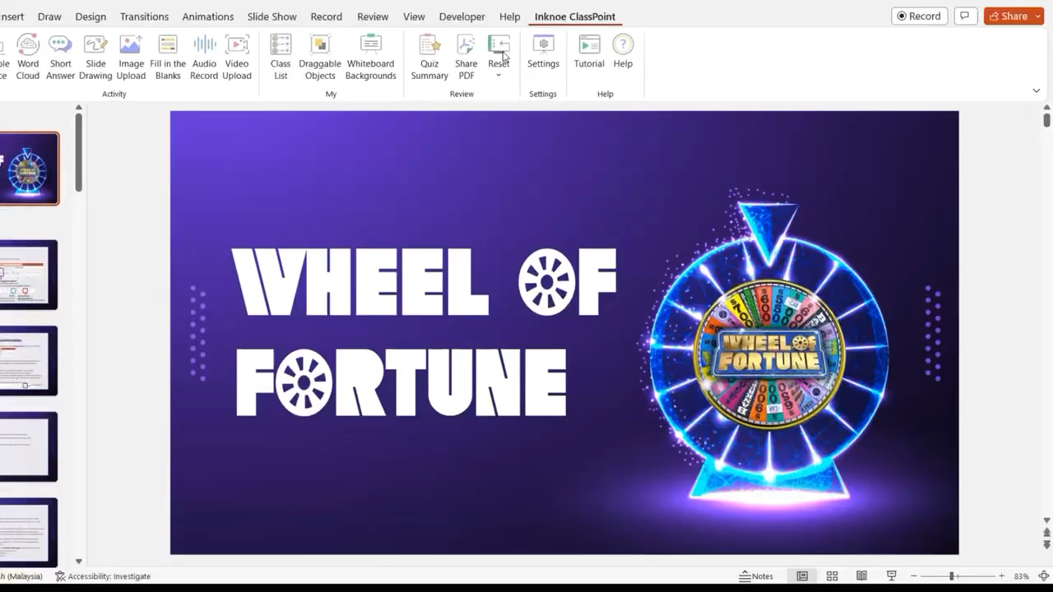
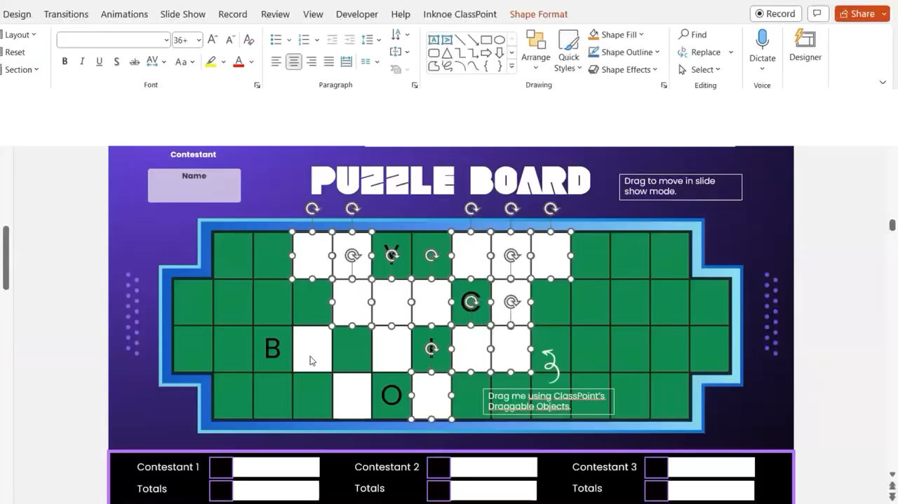
Resources
Add Wheel of Fortune Options Using Class List & Spinning the Wheel
Making Letter Boxes Movable and Revealing Letters Using Draggable Objects

Slide 27


Template created by ClassPoint
Connect with Us
Facebook
YouTube
Twitter
Pinterest
Instagram
TikTok
Try ClassPoint
for Free
LinkedIn
support@inknoe.com
www.classpoint.io

Slide 28

Instructions for use
In order to use this template, you must credit by keeping the previous acknowledgement slide.
You have the permission to:
Modify this template.
Utilise it for personal and commercial use.
You are not permitted to:
Provide ClassPoint templates (or modified adaptations of ClassPoint templates) for downloading.
Sub-license, sell or rent any portion of ClassPoint template (or an adapted rendition of ClassPoint template).
Obtain the copyright of ClassPoint temlplates.
Try ClassPoint
for Free

