Slide 1
Slide Zoom
ClassPoint AI
Quiz
with a twist!
Ready?

Slide 2

Technology in Education

Slide 3


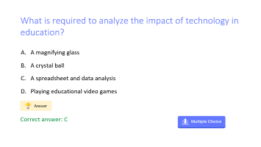


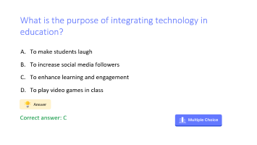

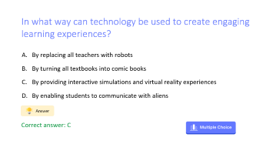
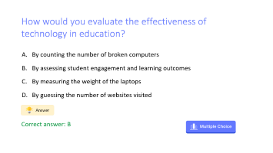
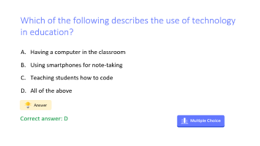

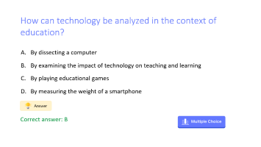

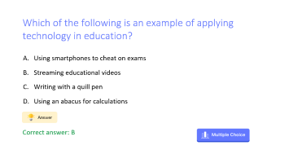

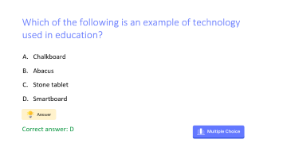


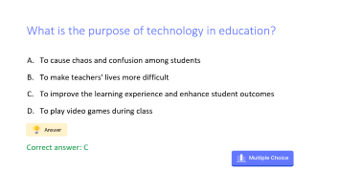
5
10
15
5
10
15
5
10
15

Slide 4



Which of the following is an example of technology used in education?
Chalkboard
Abacus
Stone tablet
Smartboard
Correct answer: D

Slide 5
What is the purpose of integrating technology in education?
To make students laugh
To increase social media followers
To enhance learning and engagement
To play video games in class
Correct answer: C

Slide 6
How would you evaluate the effectiveness of technology in education?
By counting the number of broken computers
By assessing student engagement and learning outcomes
By measuring the weight of the laptops
By guessing the number of websites visited
Correct answer: B

Slide 7
Which of the following is an example of applying technology in education?
Using smartphones to cheat on exams
Streaming educational videos
Writing with a quill pen
Using an abacus for calculations
Correct answer: B

Slide 8
What is required to analyze the impact of technology in education?
A magnifying glass
A crystal ball
A spreadsheet and data analysis
Playing educational video games
Correct answer: C

Slide 9
Which of the following describes the use of technology in education?
Having a computer in the classroom
Using smartphones for note-taking
Teaching students how to code
All of the above
Correct answer: D

Slide 10
How can technology be analyzed in the context of education?
By dissecting a computer
By examining the impact of technology on teaching and learning
By playing educational games
By measuring the weight of a smartphone
Correct answer: B

Slide 11
What is the purpose of technology in education?
To cause chaos and confusion among students
To make teachers' lives more difficult
To improve the learning experience and enhance student outcomes
To play video games during class
Correct answer: C

Slide 12
In what way can technology be used to create engaging learning experiences?
By replacing all teachers with robots
By turning all textbooks into comic books
By providing interactive simulations and virtual reality experiences
By enabling students to communicate with aliens
Correct answer: C

Slide 13

Template created by ClassPoint
Connect with Us
Facebook
YouTube
Twitter
Pinterest
Instagram
TikTok
Sign up for free to get ClassPoint here
LinkedIn
support@inknoe.com

