Slide 1

InnovateX Solutions, Inc.
Alex Bennett
As the visionary leader of the company, Alex Bennett sets the strategic direction, ensuring innovation and growth while fostering a collaborative and inclusive corporate culture.

Slide 2
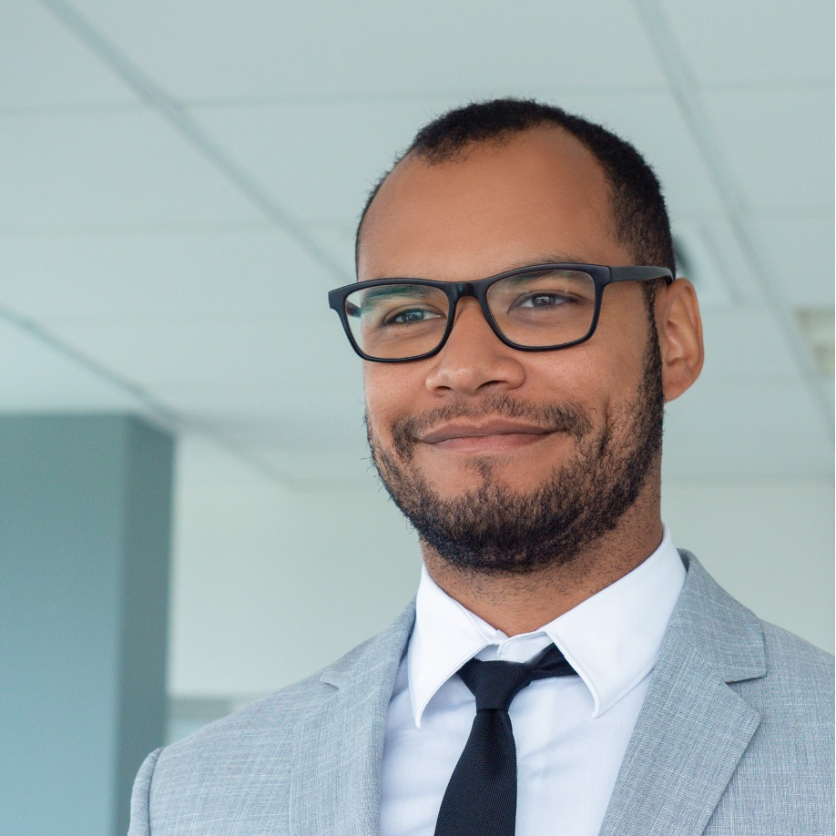
InnovateX Solutions, Inc.
Dave Rodriguez
With a keen eye for financial strategy, Dave Rodriguez oversees fiscal operations, guiding the company's financial health and stability with precision and a commitment to success.

Slide 3

InnovateX Solutions, Inc.
Mia Thompson
As the creative force behind the brand, spearheads marketing initiatives, driving brand awareness and engagement through innovative campaigns that resonate with the target.

Slide 4

InnovateX Solutions, Inc.
James Harrison
Driven by a passion for technology, he leads the tech of the company, ensuring cutting-edge solutions and a robust IT infrastructure to keep the organization at the forefront.

