Slide 1

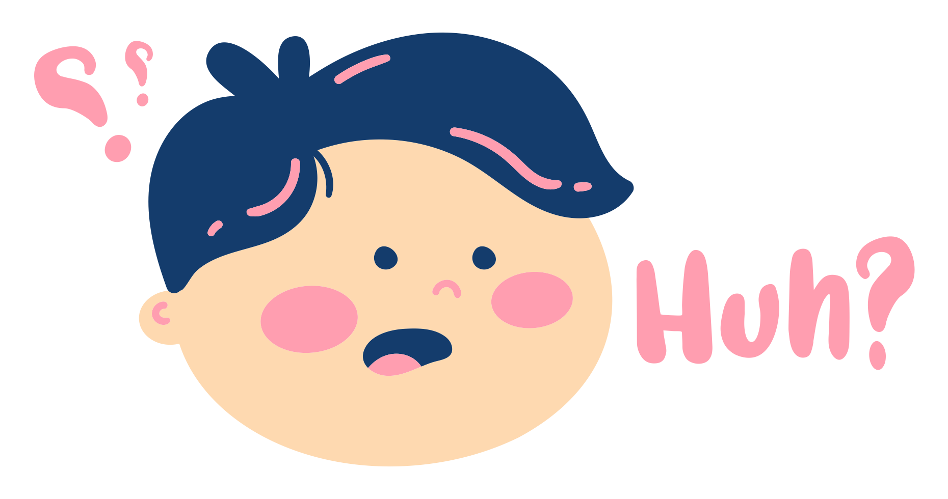
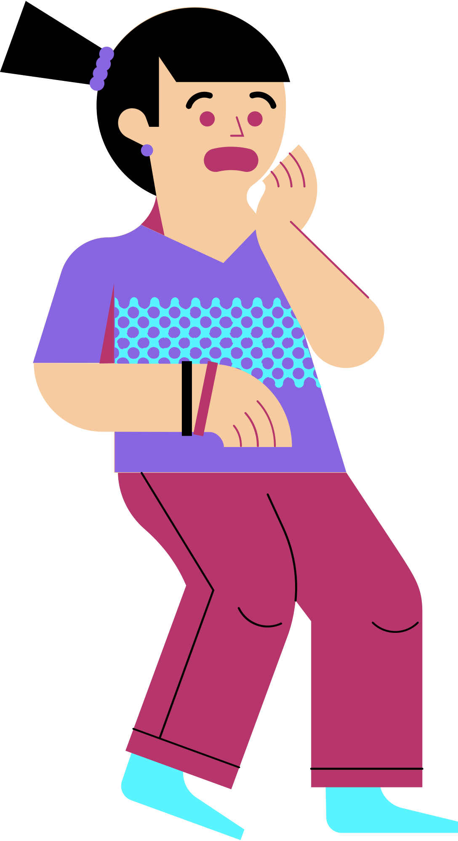
Mandela Effect
Quiz
What do you believe?

Slide 2
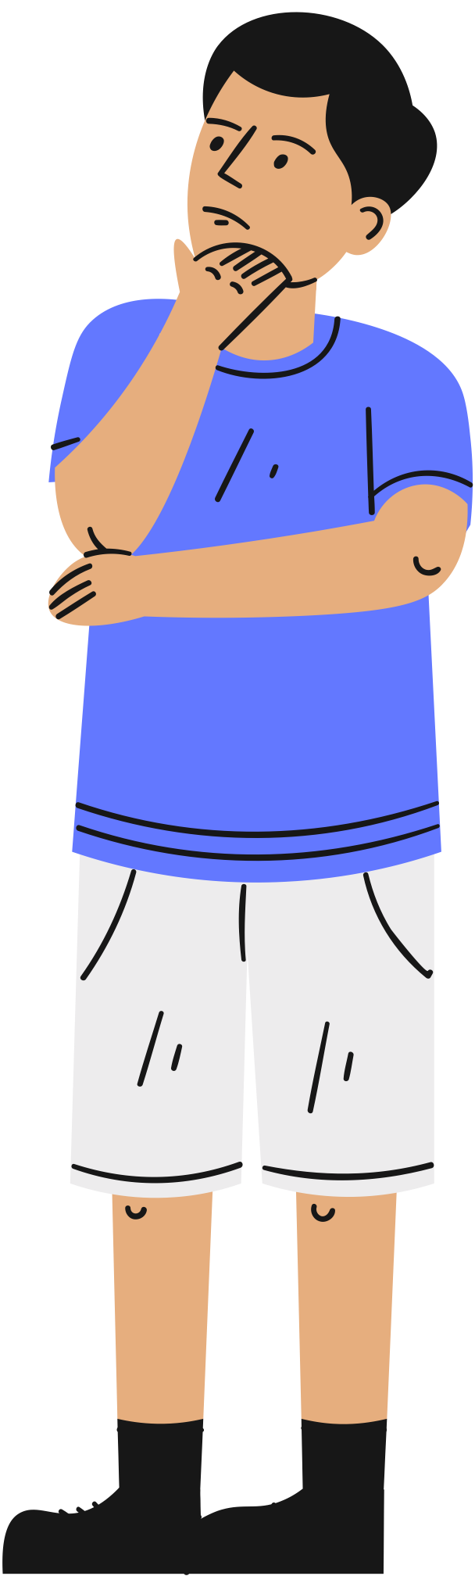
What is the Mandela Effect?
The Mandela Effect describes a circumstance in which a huge group of individuals believes something happened when it didn’t.
Fiona Broome originated the phrase “Mandela Effect” in 2009 when she created a website to document her observations. Broome was at a seminar on how she recalled former South African president Nelson Mandela’s death in a South African prison in the 1980s.
Nelson Mandela, on the other hand, did not die in a prison in the 1980s; he died in 2013 at the age of 95.

Slide 3
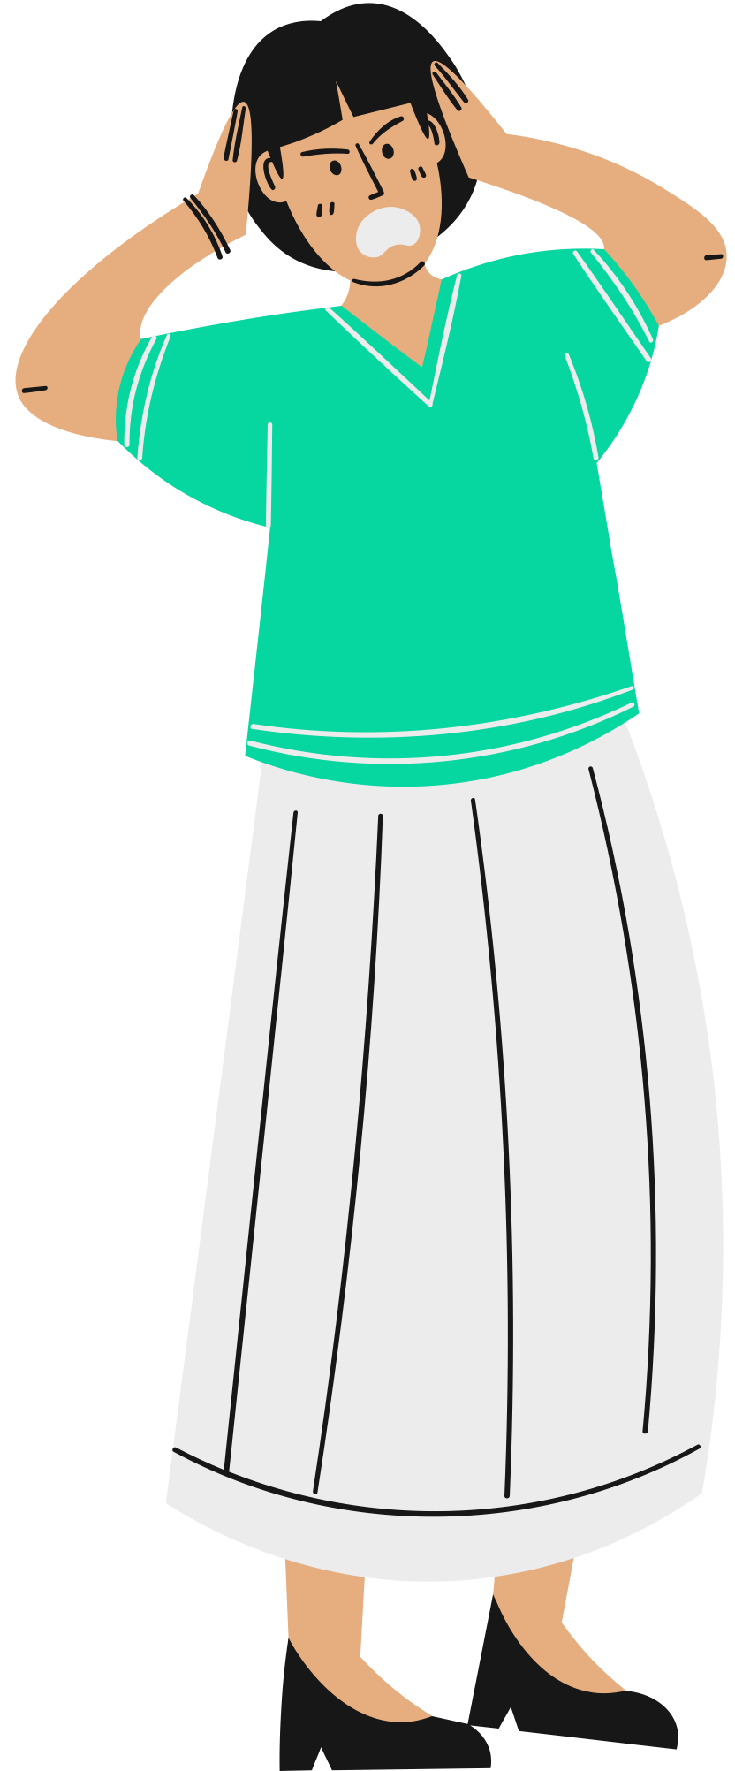
Understanding its origin
Broome realized she wasn’t alone when she started talking to other individuals about her memories. Others recalled witnessing footage of his death on the news, as well as a speech delivered by his widow.
Broome was taken aback by the fact that so many people could recall the same exact event in such vivid detail despite the fact that it had never occurred.
Her book publisher encouraged her to start a website to discuss the Mandela Effect and other such instances. And that is how the Mandela effect came into being and people started to read and recognize more about it.

Slide 4
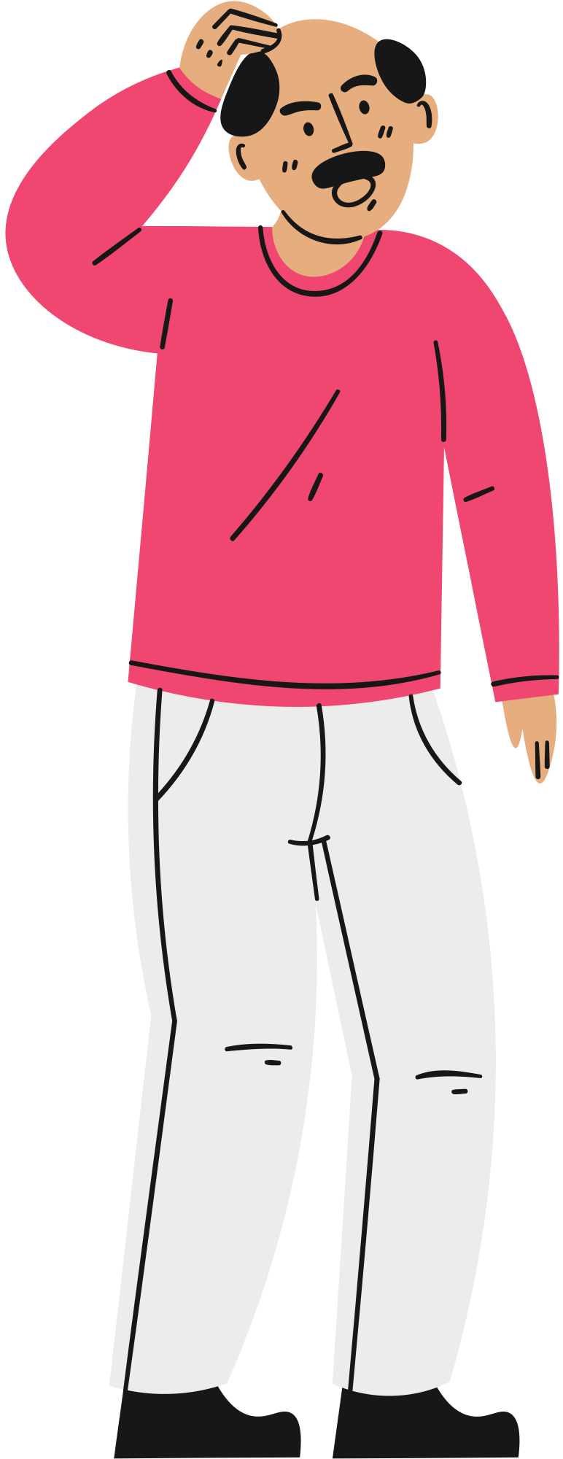
What causes this phenomenon?
The Mandela effect is a type of Confabulation, according to doctors. Confabulation is akin to “truthful lying.”
Without meaning to deceive or lie to others, a person generates a false memory. Rather, they’re trying to fill in blanks in their own recollection.
It is a common false recollection shared by a huge group of people for no apparent reason. That particular set of people remembers the incident in a peculiar way as if they are living in a parallel reality.

Slide 5
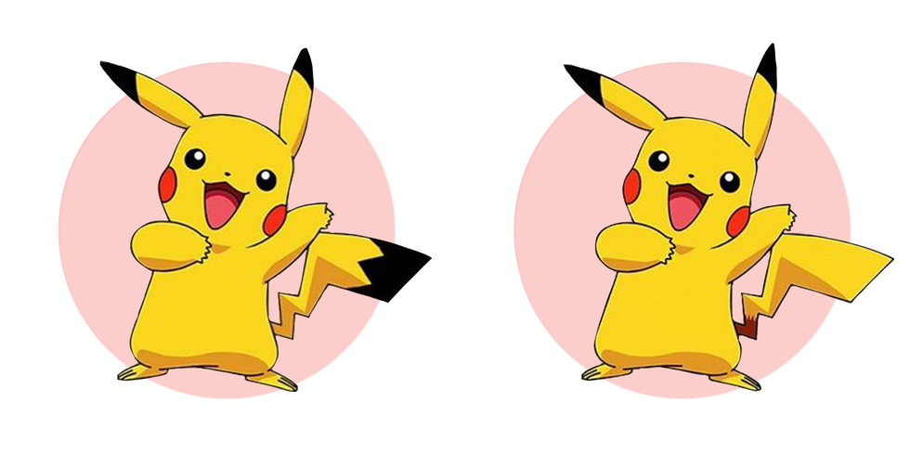
Example
Though some may clearly remember black detailing on the Pikachu's tail, in reality, it's just yellow.

Slide 6
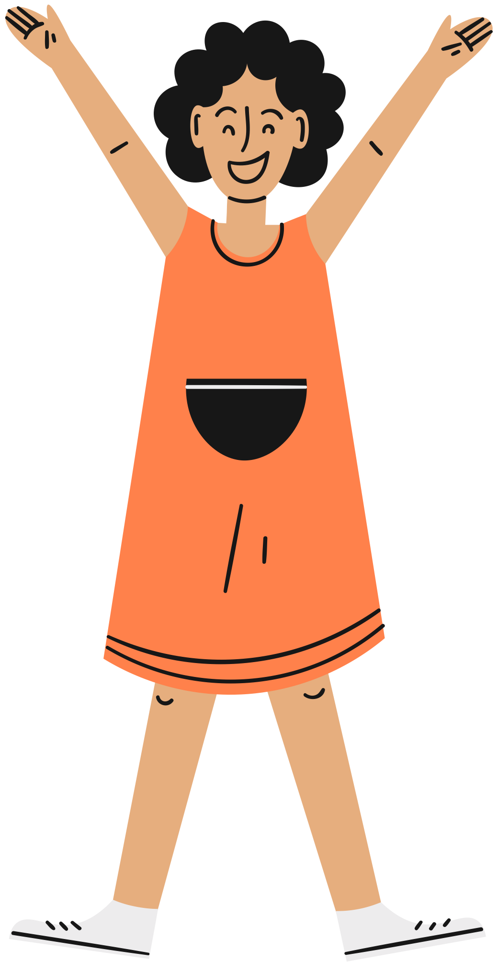
Are you ready
to play?

Slide 7
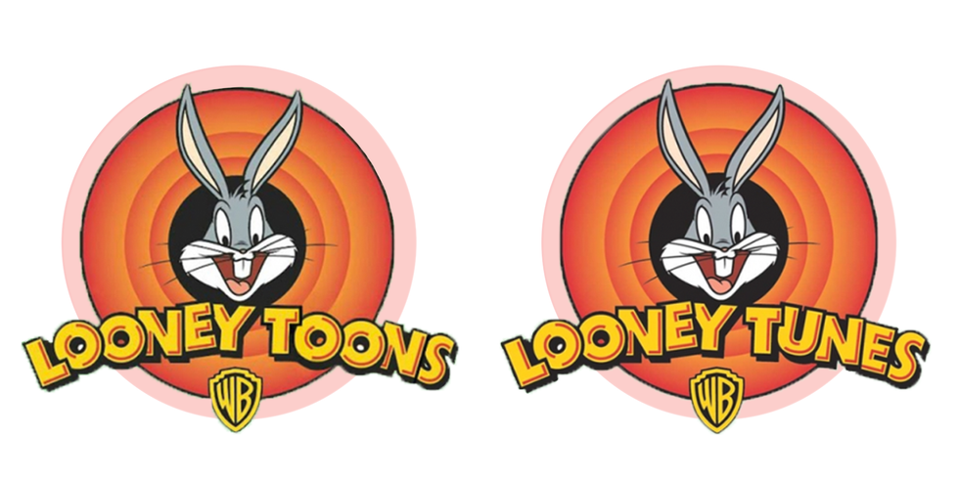

Question #1
A
B

Slide 8

Answer
It makes almost zero sense, but yes, the cartoon was spelled as "Tunes."

Slide 9

Question #2
A
B

Slide 10
Answer
Nope. It's Skechers without the "T". We got tricked, too!

Slide 11
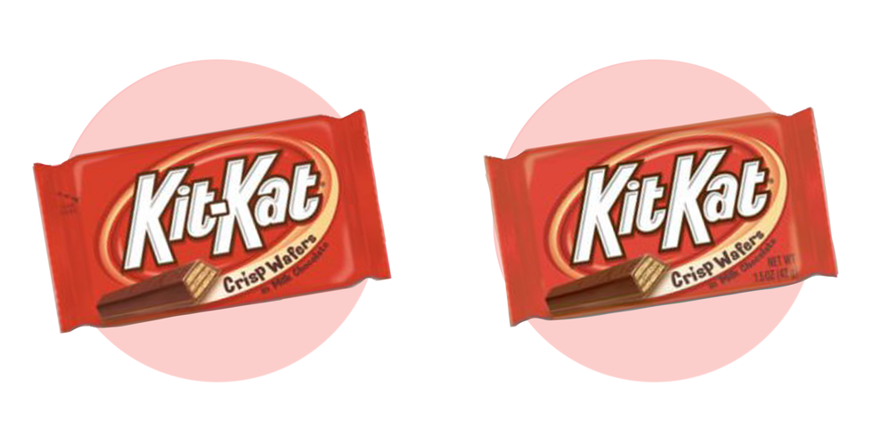
Question #3
A
B

Slide 12
Answer
Yup! You are a true chocolate junkie. There's no hyphen is KitKat!

Slide 13
Question #4
"Magic, Mirror
on the wall...."
"Mirror, Mirror
on the wall...."
A
B

Slide 14
Answer
"Magic, Mirror
on the wall...."
"Mirror, Mirror
on the wall...."
While we think it has always been "Mirror, Mirror...", the Wicked Queen in Snow White actually says "Magic, Mirror..." Childhood ruined!

Slide 15
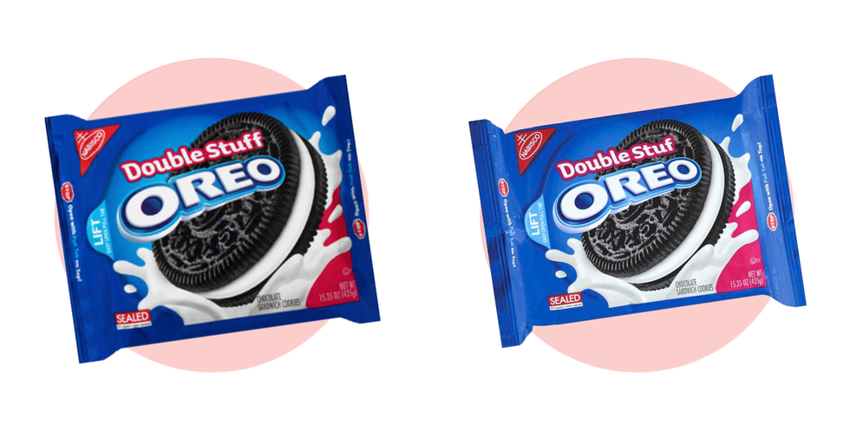
Question #5
A
B

Slide 16
Answer
Gotcha! It's actually Double Stuf without the extra 'F'. Sickening!

Slide 17

Template created by ClassPoint
Connect with Us
Facebook
YouTube
Twitter
Pinterest
Instagram
TikTok
Sign up for free to get ClassPoint here
LinkedIn
support@inknoe.com

