Slide 1
Welcome to ClassPoint in Classroom
Webinar Series

Slide 2
Programme Outline
Sharing by Dr Yong Hsin Ning
1
2
Live Q&A
Quiz Competition
3

Slide 3
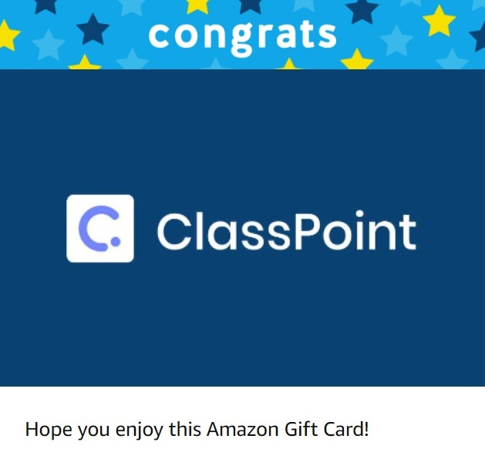
Quiz competition at the end…ATTRACTIVE Prizes to be won!
ClassPoint PRO
Amazon Gift Vouchers
$20 / $15 / $10

Slide 4
Programme Outline
Sharing by Dr Yong Hsin Ning
1
2
Live Q&A
Quiz Competition
3
Announcement of Winners
4
Feedback
5

Slide 5
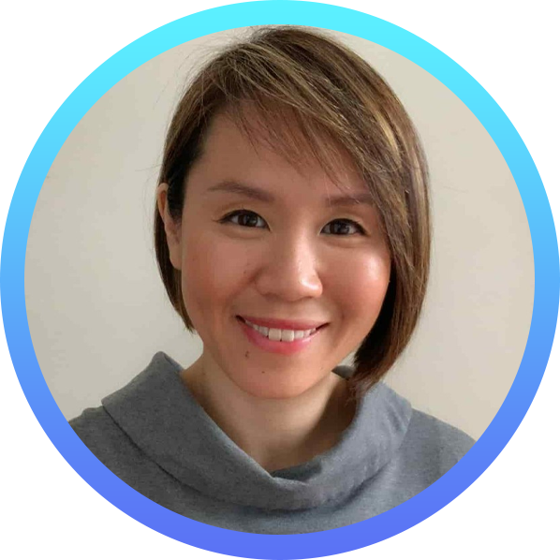
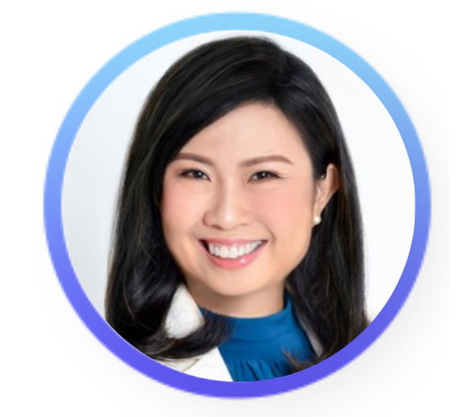
Engaging Adult Learners in a Vibrant Learning Classroom
Host
Guest Speaker
Vanessa Tsang
Principal Education Specialist
Inknoe, Singapore
Dr Yong Hsin Ning
Co-Founder of Change Voyage Consulting
SMU Adjunct Faculty

Slide 6
About Our Host
For the past two decades, Vanessa had been a trainer and educator in Outward Bound Singapore and local institutes of higher learning.
Passionate about empowering professionals to enhance engagement with their learners through effective facilitation strategies.
Her enthusiastic deliveries never fail to energise her learners & the tips she shares are known to be relevant and practical.
Vanessa Tsang
Principal Education Specialist Inknoe, Singapore

Slide 7
About Our Guest Speaker
Dr Yong is an adventurer.
In her 25 years of career, she has experienced the joy (and woes) of being a tax accountant, a management consultant, adult student, an entrepreneur and an educator.
Now, she leverages her unique role as an entrepreneur and an educator to deliver business and change management related programmes to a wide-range of adult learners.
She is passionate in designing learning that sticks and which delivers lasting impact beyond the classroom.
Dr Yong Hsin Ning
Co-Founder of Change Voyage Consulting SMU Adjunct Faculty

Slide 8
Engaging Adult Learners in a Vibrant Learning Classroom
8
Inknoe Webinar Series
15 October 2021

Slide 9
About Me
Notes:
Before I intro myself, can I have a show of hands how many of you have watched Squid Game?
If you have, then you know that these 3 shapes appeared on the namecard for the selected ones to enrol into the game.
Those of you who haven’t, don’t worry about it, because I’m not gg to make any further reference to the show.
__
About me of the speaker is always kind of boring, so I thought of using these 3 shapes to make it more interesting.
My professional career first starts with a square…
Which to me means being regular and conventional, like many of my peers who graduated the same time as me. (next slide)

Slide 10
About Me
Tax Accountant
Notes:
I spent 20 years as a corporate citizen, of which the first 3 years was spent as a tax accountant.
Although I did well, I felt that it wasn’t something that I wanted to do on a long term, so I went off to be a management consultant at Accenture

Slide 11
About Me
Tax Accountant
Change Management Consultant
Notes:
And I stayed on for the next 15 years.
Over the 15 years, I got married had two kids and eventually I felt that the hectic worklife was not working out well with my family.
I didn’t know what to do next, so I…

Slide 12
About Me
Permanent Head Damage
Notes:
Decided to give myself a Permanent Head Damage, went to do a PhD, and while waiting for data collection, got very bored and started my first company called Change Voyage Consulting.

Slide 13
About Me
Parent/Daughter/Wife
Me
Educator
Entrepreneur
Notes:
I graduated in 2017, and then I started teaching and running my consultancy. So now, I spend time teaching in SMU as an adjunct faculty; in my capacity as an entrepreneur, I also deliver numerous learning programmes via 2 companies, change voyage and the biz lab. which I’ll share more later. Last but not least, I am spending a lot of time fulfilling my responsibilities as a member of immediate and extended family

Slide 14
Vanessa to come in to link

Slide 15
Who & What I Teach
University
Self-Employed
Final Year Undergrads ~24 - 26
SME Business Owners
Early-Stage Entrepreneur
Corporations
Subject
Business Model Design, Entrepreneurship
Change Management, Innovation Mindset
Middle-Senior Management
Project Managers

Slide 16
V: I’m sure it has been a journey….can you share with us what the initial situation was like…

Slide 17
In The Beginning…
My Role Perception
Knowledge synthesis & simplification
“Do You Understand?”
Knowledge
Me: “The Expert”
Learner
My Teaching Approach
Concept
Apply
Debrief

Slide 18
V: So what is the impact to the learner?

Slide 19
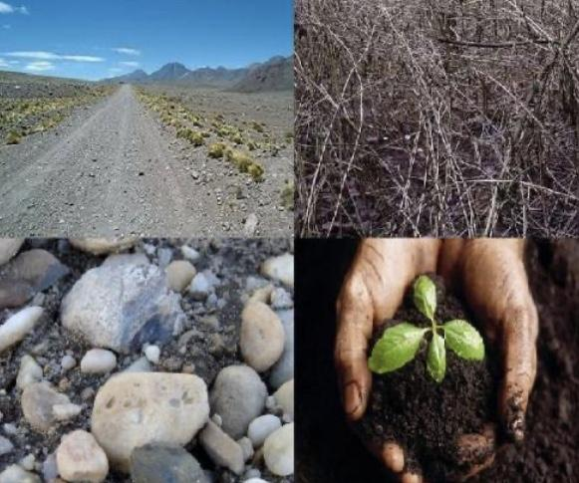
The Issue…
The Implication…
Concept
Learner’s Existing Understanding & Context
Weak Internalisation Confusion | Forgettable
Source of picture: https://nathanpipho.com/2020/07/12/parable-of-the-four-soils/

Slide 20
V: Malcolm Knowles…
So what did you do?

Slide 21
Then How?

Slide 22
Now…
My Role Perception
Me: “The Conduit”
Knowledge
Experience or Paradigm
Internalised Knowledge
Improvement In Approach
Uncover
Connect
Structure
Apply
Debrief

Slide 23
The Old…
The New…

Slide 24
What Are Some Techniques You Are Using to Motivate Learners?

Slide 25
ARCS Model of Instructional Design (Keller, 1987)
Familiar Context
Relevance
Student Motivation
Controversy
Feedback
Attention
Confidence
Clarity
Suspense
Entertaining
Scaffolded Instructions
Satisfaction
Keller, J. M. (1987). Development and use of the ARCS model of instructional design. Journal of instructional development, 10(3), 2-10.
Applicability
Recognition

Slide 26
V: how do you use CP and Padlet in your class

Slide 27
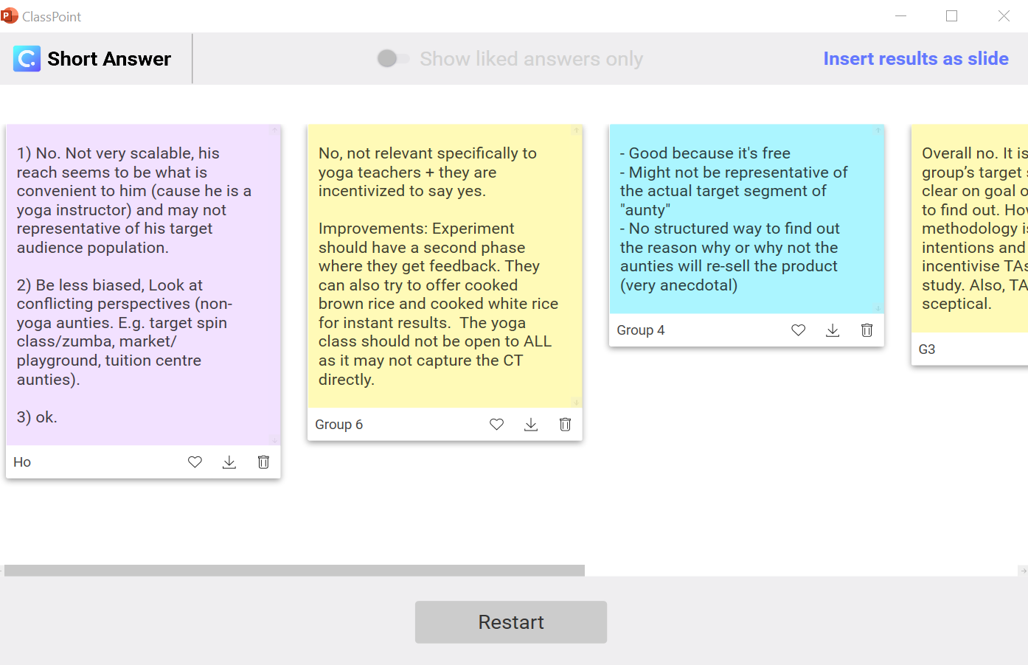
Application of ClassPoint
Question in PowerPoint
Group Posts Answers Via CP
Answers Inserted Into PowerPoint
Annotation by instructor

Slide 28
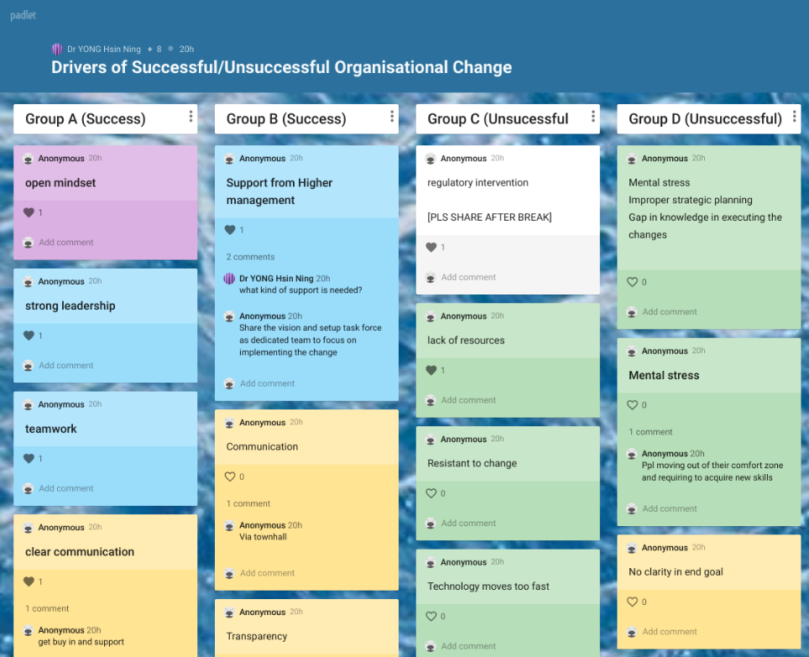
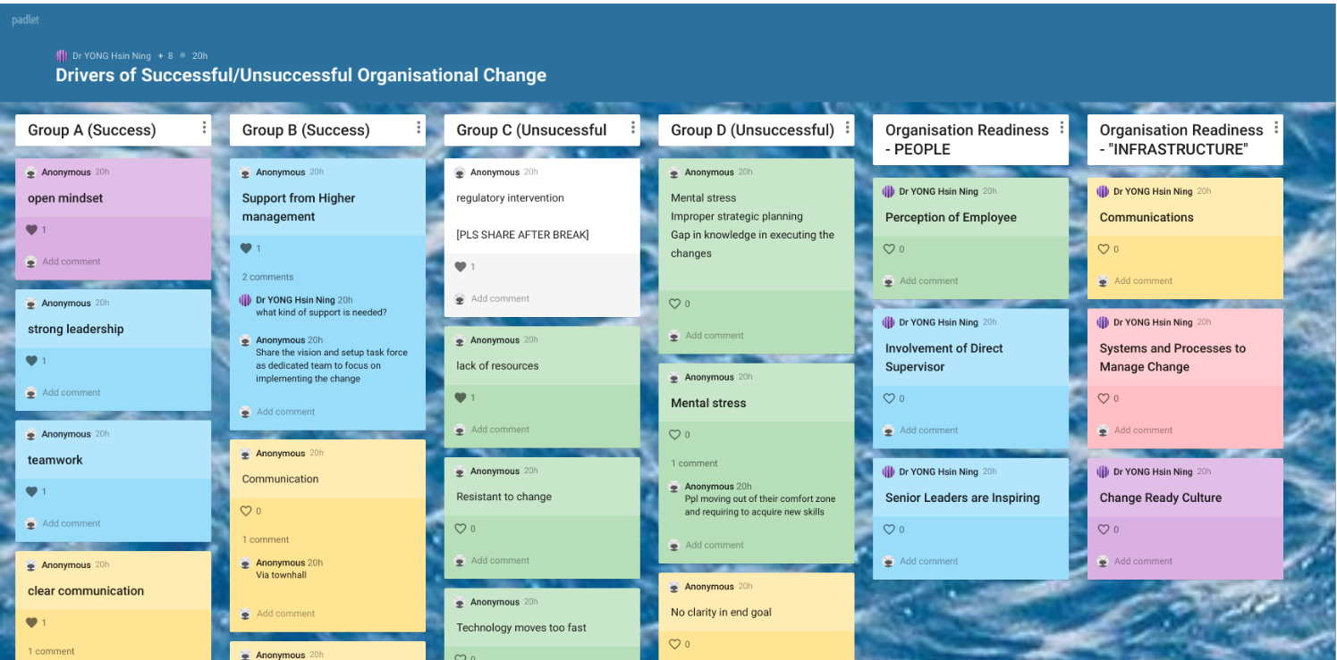
Application of Padlet
Question in PowerPoint
Individuals Brainstorm Within Their Group (original entry not colour coded)
Instructor inputs framework and colour codes the responses during break
Colour Code To Relate Answers To Framework

Slide 29
How else can you make learning stick?

Slide 30
V: Other than using these tools, what else is needed to make Learning Stick?
HN – create on slide on the fly

Slide 31
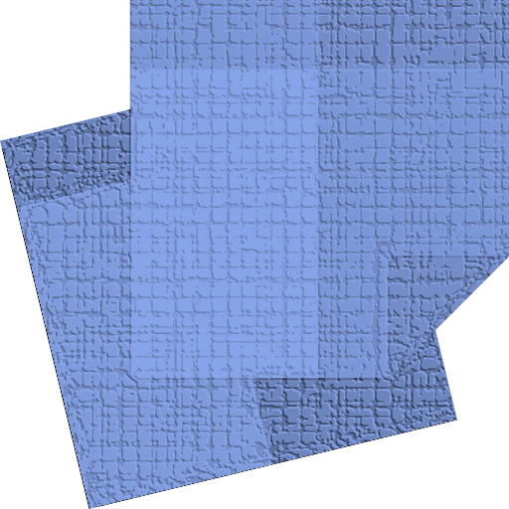
OR

Slide 32
Reinforcement of Concepts
In Classroom
Uncover
Connect
Structure
Apply
Debrief
Reinforce
Application Outside Classroom

Slide 33
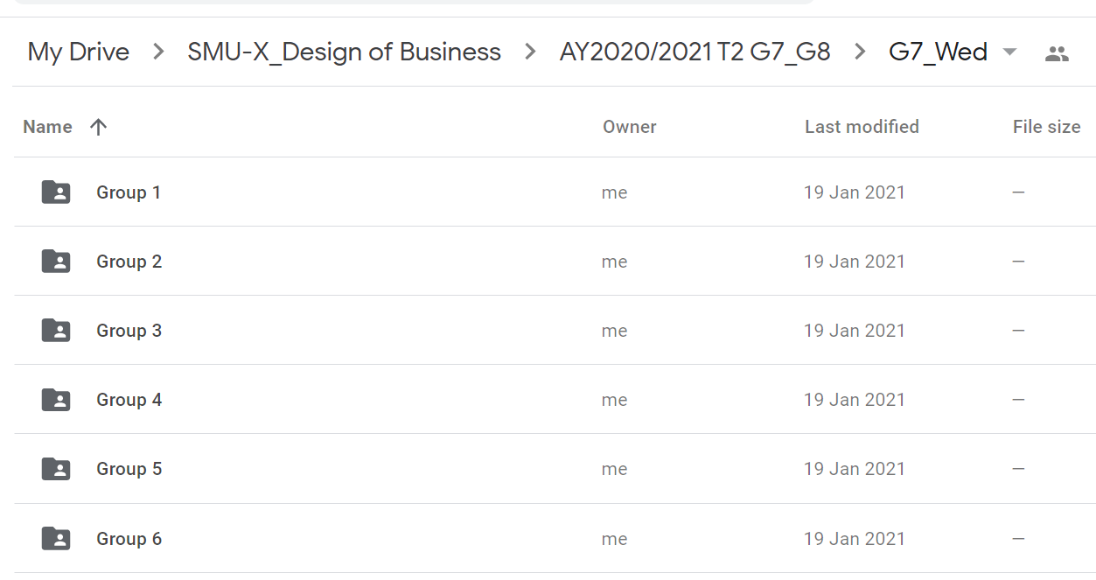
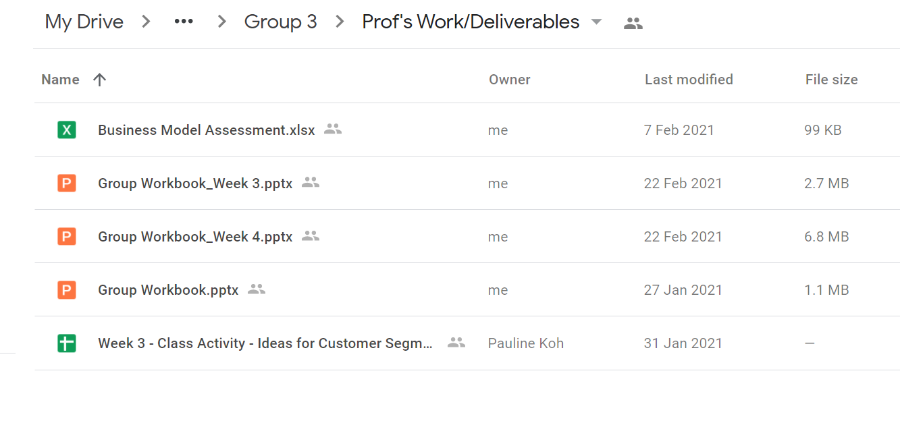
Weekly Scaffolded Homework
Collaboration folders are set up for each team at the start of the course
A new set of template will be uploaded each week
Each team will work on the blank template during class and after

Slide 34
Integration of Project Work Into Learning Programme
6- week change management programme for HR leaders
Integrate project work and change management theory
Learners are supported during class discussions and after class coaching

Slide 35
V: so what is the impact of the change on the learners

Slide 36
Evidence of Impact
Survey Questions | 2021 Q1 Run
How relevant is this course to your role? | 100% very relevant
I have been provided tools and techniques for CM | 100% agree
My understanding and appreciation in CM has increased because of this workshop | 100% agree
I feel I have more knowledge and skills to effect change in my day to day work | 100% agree
I would recommend this course to my colleagues | 100% agree
I have applied CM concepts to a project during this workshop | 100% agree
Overall, I felt that the quality of my project work has improved over the course of the program | 100% agree
My manager has supported me during the course | 100% agree
Participants reported increased confidence in using CM
Immediate application and visible increased in quality of their own projects

Slide 37
Feedback From Participants
What I found most useful was the action learning project which helps me to have the exposure to really apply what I have learned in this programe. Plus sharing, coaching and feedback sessions.
Big thanks to both facilitators who shared their knowledge and create a good learning atmosphere where everyone can engage with fun plus continued support with project coaching.
I feel so much more confident with Change Management now
My perspective has shifted because of this course. I can see my blind spots from before.

Slide 38
V: so what are the top 2 tips…

Slide 39
In Summary…

Slide 40
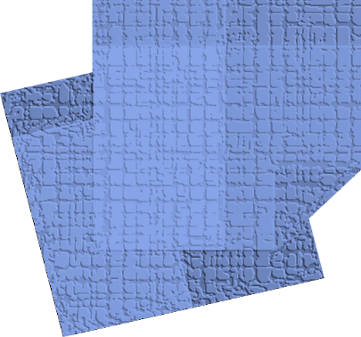
In Summary…
Uncover + Connect To Existing Experience
Reinforce through in class and outside class application
Learning that Sticks!!!

Slide 41
Live Q&A
Type or raise virtual hands
Question with most votes
💗 💗 💗

Slide 42
Quiz Competition…

Slide 43
ATTRACTIVE Prizes!
Top 6 winners
PRO
(3 months)
Top 3 winners
+
PRO
(3 months)
Amazon
Gift Vouchers!
$20 / $15 / $10

Slide 44
Instructions
Join class
4 questions
30 sec response time per question
Winning formula: Speed + Accuracy

Slide 45
Qn 1. What does the “C” in the ARCS model stand for?
Clarity
Confidence
Controversy
Consolidation

Slide 46
Qn 2. Which edtech tool was used for audience engagement in this webinar?
Padlet
Mentimeter
ClassPoint
Google doc

Slide 47
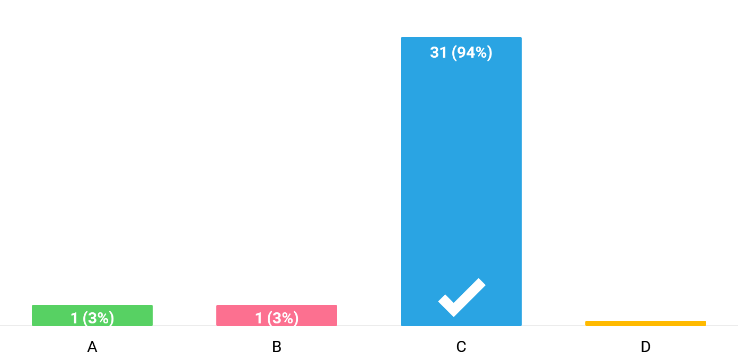
Multiple Choice Submissions
Details can be found in the Notes section below
Notes:
A(1): KT
B(1): Asyraf
C(31): Ed, Edmond Toh, Naz, Jason Yew, J, Kh, Ariel, Brian, Matzz, Natalie, EKG, L, W, CH, Joyce Teo, alvinmok, Lee, Eric, Jill, Bumblebee, Art Aguila, Imelda Publico, Role play, Kc, w, Miyuki, Len, Gamar, Cc, S, Josephine
D(0):
No submission from: V, MTan, edwee, Mk, Dee, Ting, DY, Dh, Kf, JT, Minna, Steph

Slide 48
Qn 3. Which features of the edtech tool were used by Dr Yong in this webinar? (You may choose more than one option)
Word cloud
Short answer
Slide drawing
Multiple choice

Slide 49
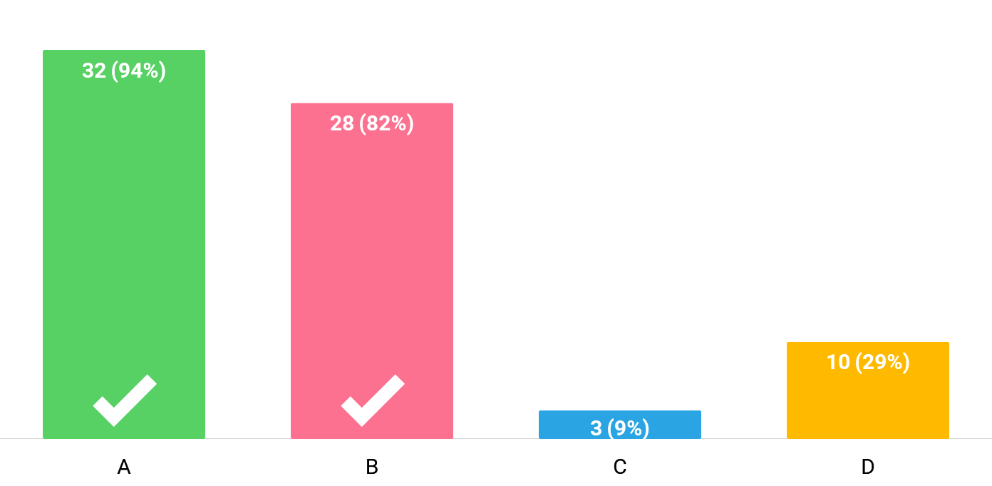
Multiple Choice Submissions
Details can be found in the Notes section below
Notes:
A(32): EKG, Matzz, Edmond Toh, Kh, Naz, Jason Yew, W, Joyce Teo, Eric, Ed, Bumblebee, J, Asyraf, Kc, L, CH, Miyuki, Ariel, Brian, Cc, Role play, w, Jill, S, KT, Josephine, Imelda Publico, Len, alvinmok, Art Aguila, Gamar, MTan
B(28): EKG, Matzz, Edmond Toh, Kh, Naz, Jason Yew, W, Eric, Ed, Bumblebee, J, Asyraf, Kc, L, Miyuki, Ariel, Role play, w, Lee, Jill, KT, Natalie, Josephine, Imelda Publico, Len, alvinmok, Art Aguila, MTan
C(3): Miyuki, S, Art Aguila
D(10): Joyce Teo, Ed, L, CH, Miyuki, Ariel, Lee, Natalie, Len, Art Aguila
No submission from: V, edwee, Mk, Dee, Ting, DY, Dh, Kf, JT, Minna, Steph

Slide 50
Qn 4. According to Dr Yong which are the TWO essential “ingredients” for learning to stick?
Drilling
Connect
Memorisation
Reinforcement

Slide 51
Winners…
“Chat” function (send message to “Host”)
Provide the following details:
Name
Mobile no.
Email address

Slide 52
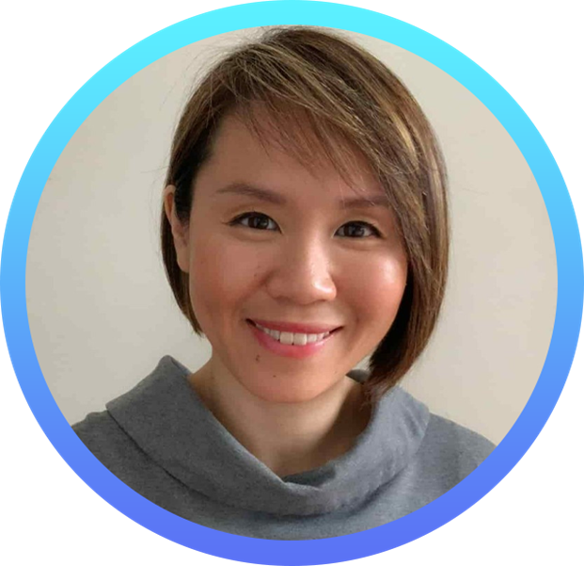
Let’s Connect
hsin.ning.yong@changevoyage.com
https://www.linkedin.com/in/hsinningyong
vanessa.tsang@inknoe.com
https://www.linkedin.com/in/vanessatsang/

Slide 53
We Would LOVE to Hear Your Views!
https://tinyurl.com/a8cspc3y

