Slide 1
ClassPoint Whiteboard Background Examples

Slide 2
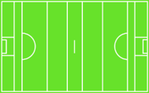

Slide 3
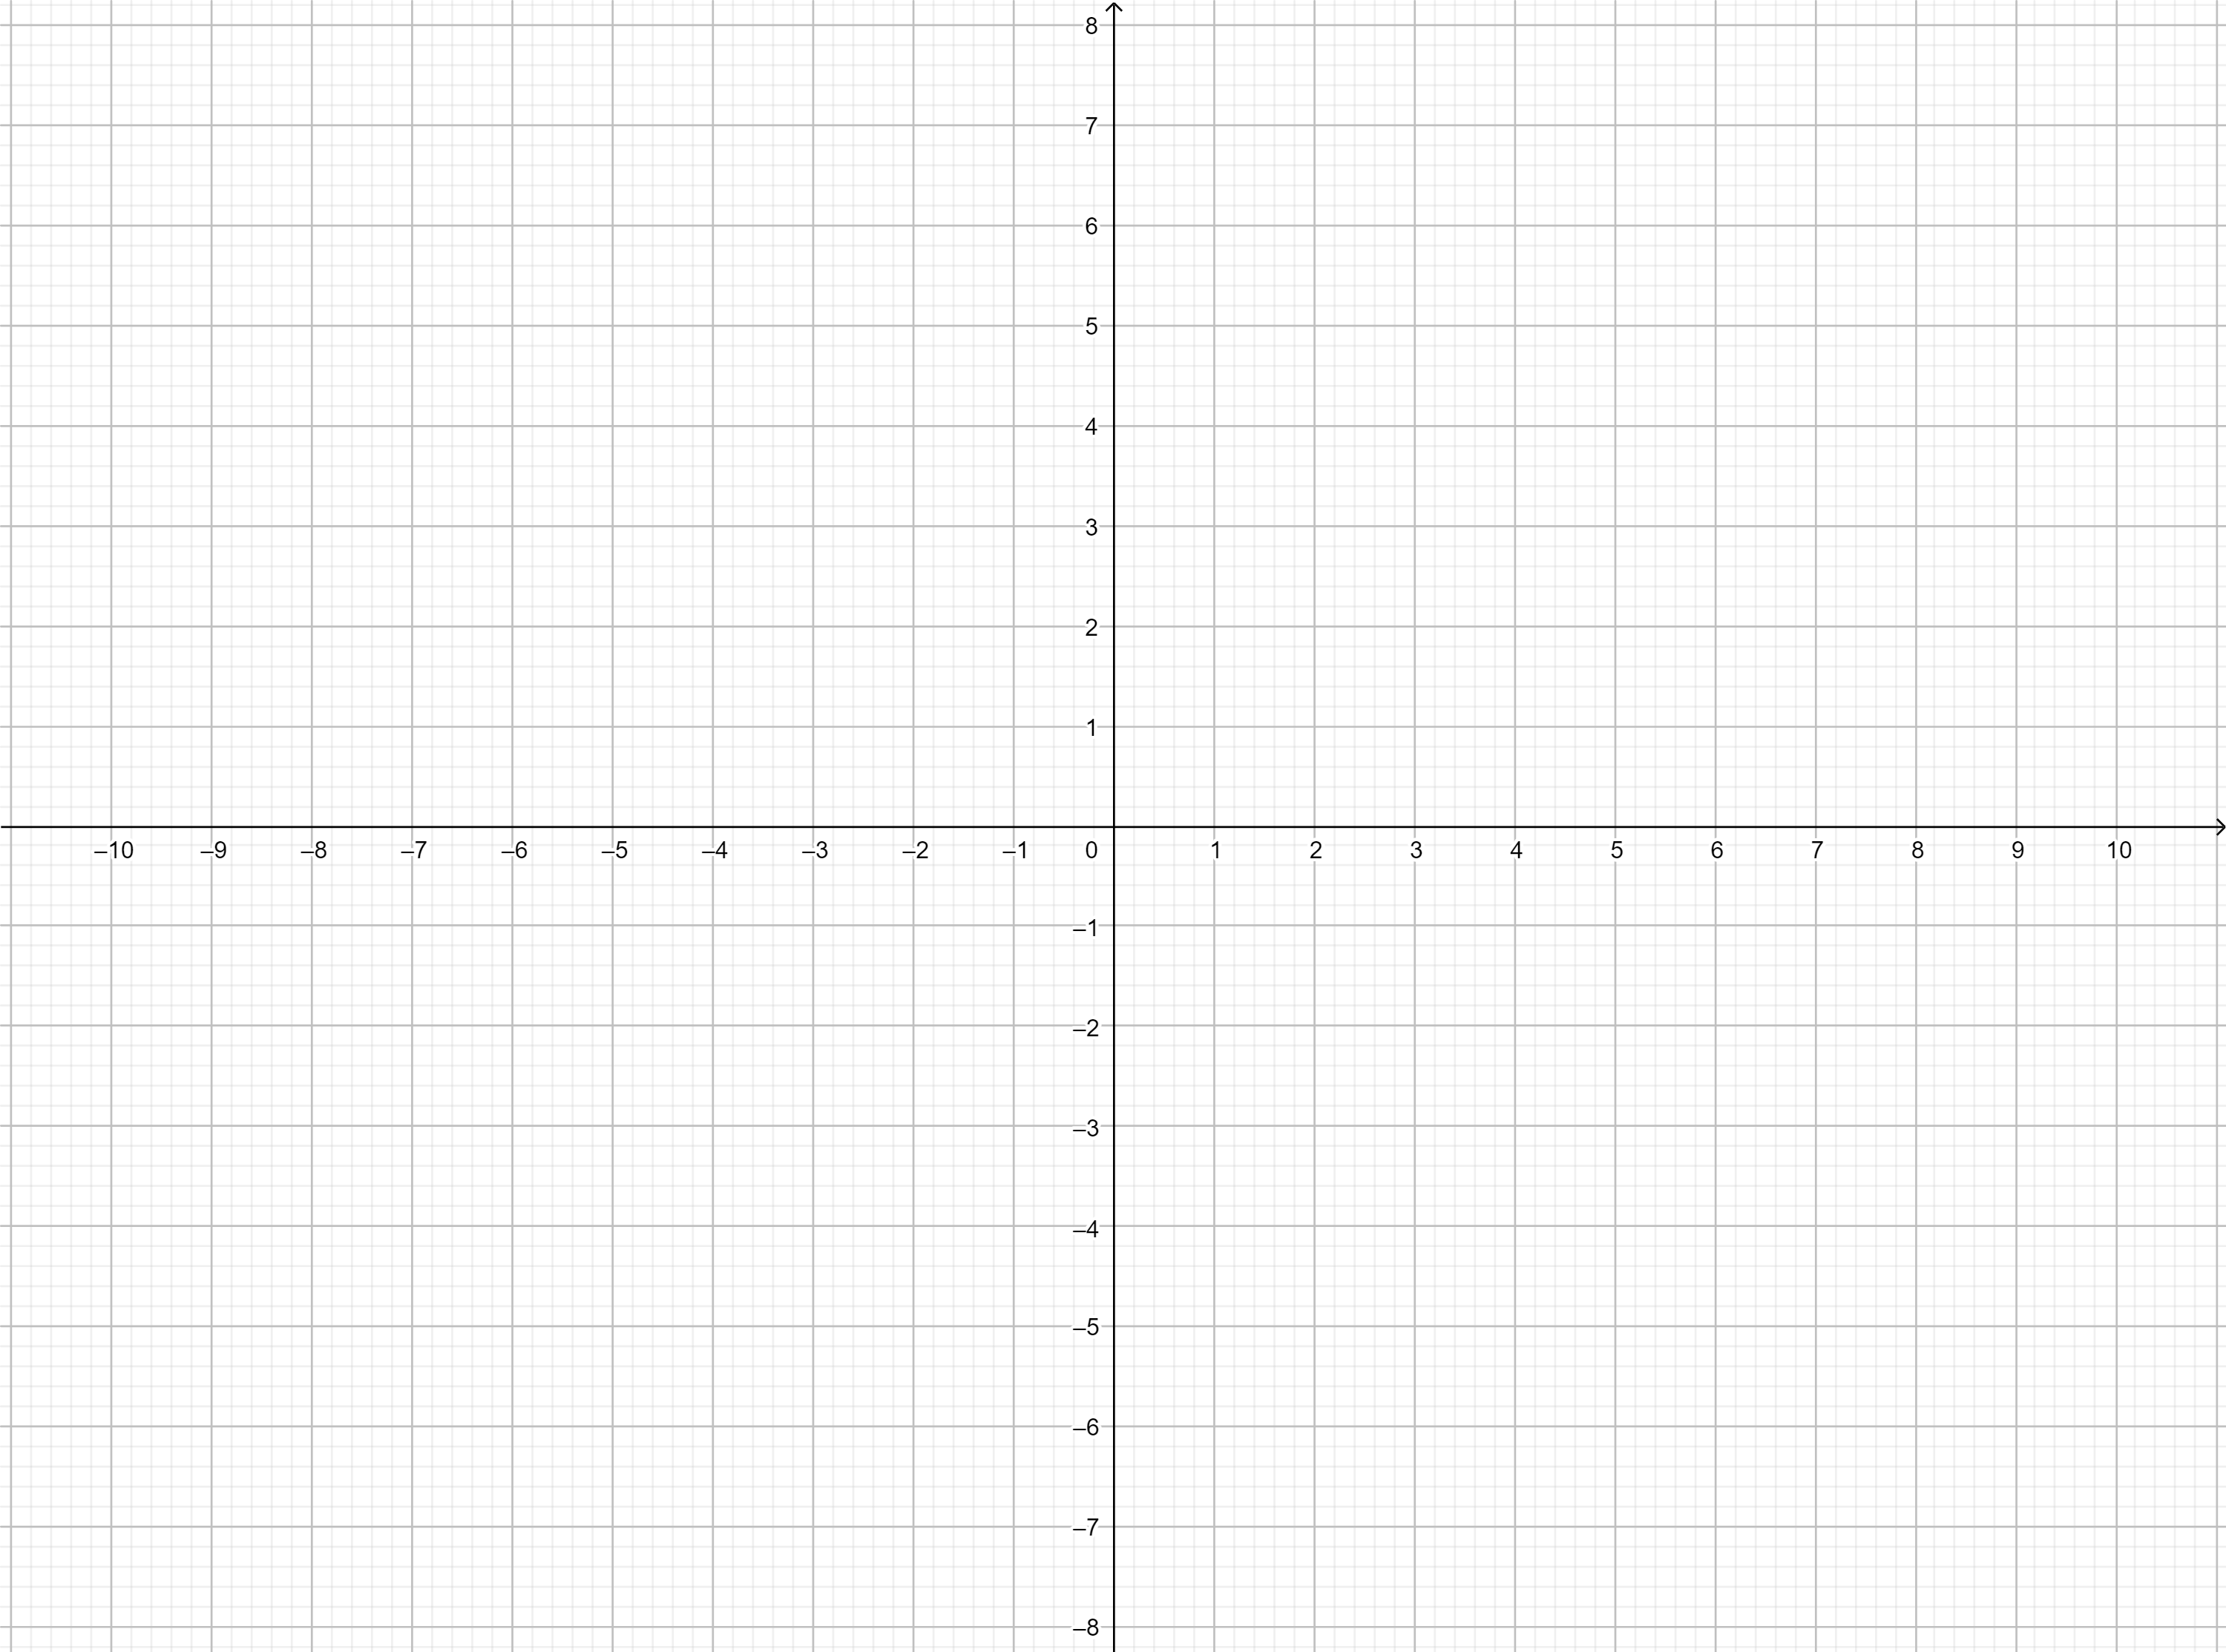

Slide 6
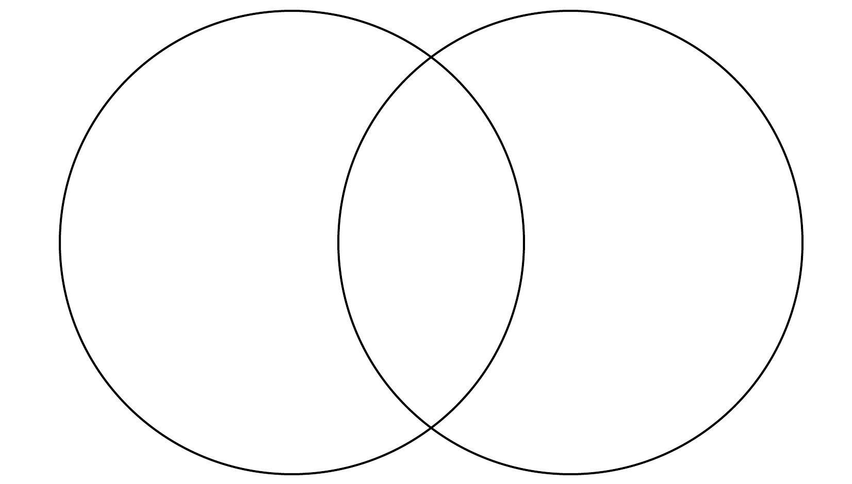

Slide 8
Know | Want to Know | Learned

Slide 9
