Slide 1
5 Super Fun Back-to-School Icebreakers

Slide 2
Find a picture of a country you would like to visit. Why would you like to go there?
(Sshh…keep it a secret! 🤐)
Submit a cropped image of the country’s landmark to give us a clue!

Slide 3
If you could go back in time, which period would you go to? Who would you like to meet?

Slide 4
How do you feel about subject X?
Express how you feel towards this subject by completing this face with eyebrows, mouth, tears, sweat, etc…

Slide 5
Snap one picture consisting of items in your house/classroom/school that makes you…
Happy
Sad
Irritated

Slide 6
Would-you-rather series…

Slide 7
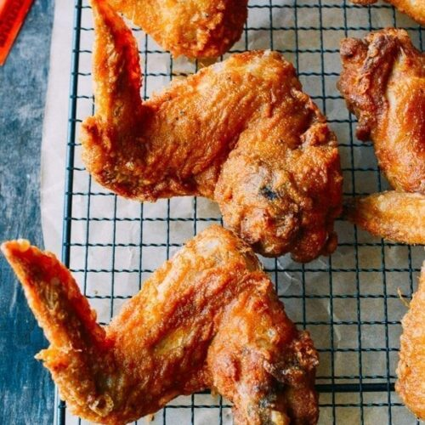
Would you rather eat….
OR
A. Vegetables
B. Fried chicken

Slide 8
Would you rather be….
OR
OR
A. Oxygen
C. Helium
B. Carbon dioxide

Slide 9
Would you rather be able to….
OR
A. Teleport...
B. Be invisible?

Slide 10
Would you rather….
OR
A. Exercise
B. Lounge by the beach

Slide 11
Would you rather….
OR
A. Give up your mobile phone for a month...
B. Give up bathing for a month?

Slide 12
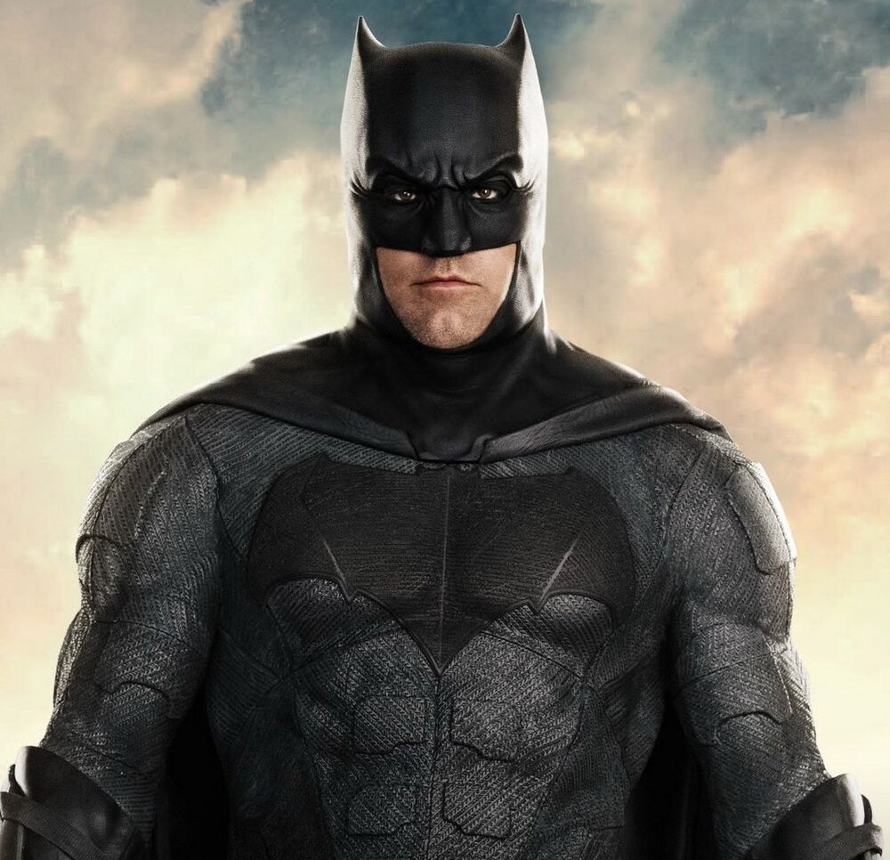
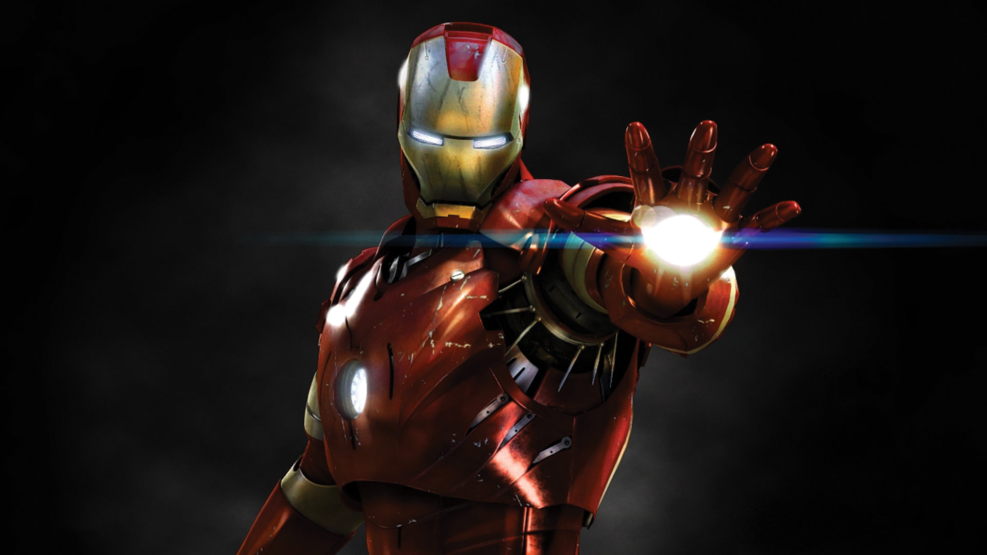
Would you rather be….
OR
A. Batman
B. Ironman

Slide 13
Would you rather….
OR
A. Have all your messages and photos leak publicly…
B. Never use a mobile phone ever again?

